Slide 1

Thyroid Cancer Risk Analysis
Team 2: Adam, Babatola, Iqra and Thinley
Providing an in-depth analysis of dataset and uncovering key insights into which demographics are at high risk of having thyroid cancer.
Notes:
Team Lead: Hi everyone. We are TEAM NAME composed of myself, Dev2 and Dev 3. We’d like to talk about our project PROJECT NAME TECHSTACK(HTML/BOOTSTRAP/JS/CSS/API) & TAGLINE

Slide 2
Overview
Providing an in-depth analysis of dataset and uncovering key insights into which demographics are at risk of having thyroid cancer:
Hypothesis 1: Age and gender influence thyroid cancer risk, with older individuals and females having a higher probability
Validation: Use box plots and regression analysis to explore how cancer risk varies across different age groups and gender distributions
Hypothesis 2: Certain countries and ethnicities have a higher prevalence of thyroid cancer due to genetic and environmental factors
Validation: Conduct geospatial analysis and visualize the distribution of thyroid cancer cases across different regions.
Notes:
Team Lead: Hi everyone. We are TEAM 1 composed of Iqra, Thinley, Babatola and Adam. We’d like to talk about our project Thyroid Cancer Risk

Slide 3
Planning & Design
Ideation
Design
Technologies
Design
Project Goal: Build interactive dashboards for data analysis
Medical Use Case: Improve decision-making through data insights of thyroid cancer risk based on demographics
Target Audience: Medical professionals, analysts, WHO and decision-makers
User Stories: "As a Medical practitioner, we want to explore demographics of thyroid cancer risk dynamically."
Intuitive UI: Clean layouts, easy navigation
Accessibility: Readable colours, labeling
Interactivity: Clickable filters, zoomable charts and maps
Hypothesis: Which demographic has high risk of thyroid cancer
Tools: Visual Studio Code, Jupyter Notebook, Power BI, PowerPoint
Wireframing: Balsamic Wireframes
Project Management: GitHub Projects, Google Meets
Version Control: GitHub for collaboration
Libraries & Frameworks: Python (Pandas, NumPy, Plotly, Seaborn, Ipywidgets, StatsModels), Power BI
Notes:
Team Lead discusses the following 1 minute

Slide 4
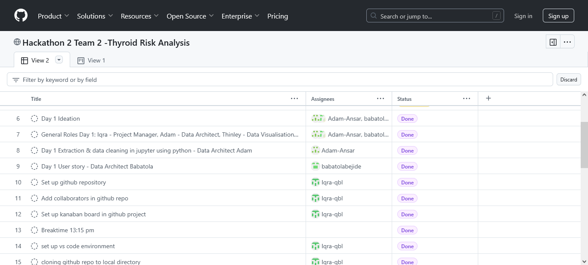
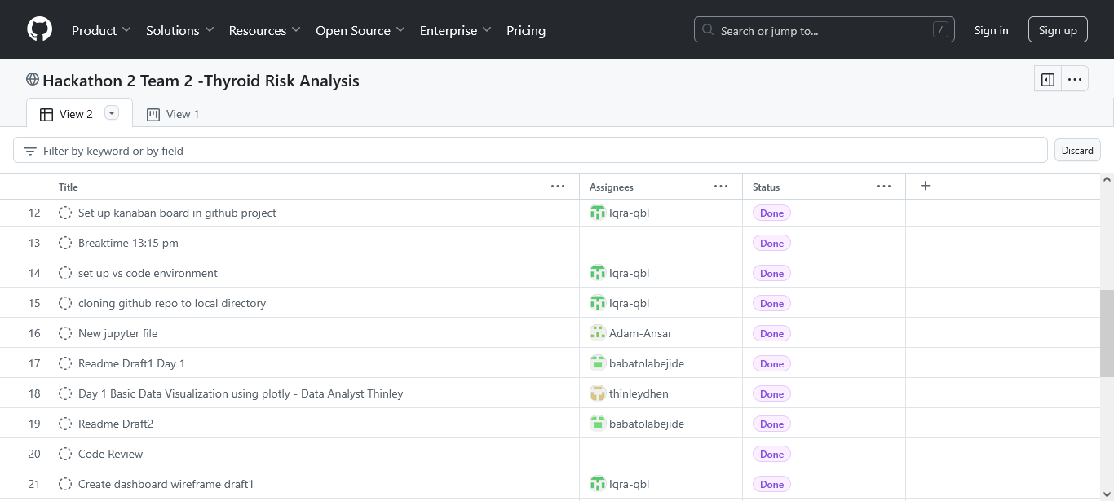
Project Board
Assigned Tasks: 30
MoSCoW Prioritisation:
Must have: an interactive dashboard and proper documentation
Should have: simple and followable code
Could have: nicely stylized code and dashboard
Would have: utilize the dataset to full potential
Project Backlog: Setting VS Code and Github collaboration
Notes:
Team Lead discusses the Project board 30 seconds! Introduces Dev 2

Slide 5
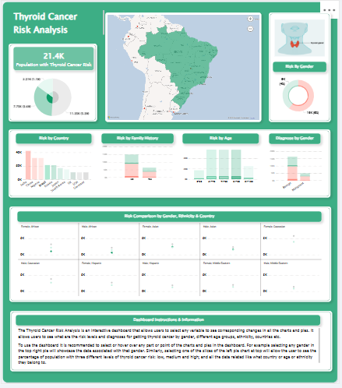
Features
Interactive: all variables i.e. age, gender, country, ethnicity, diagnosis are interlinked so selecting one will show all the relevant data across different charts and map
At the bottom there are instructions on using the different features of the dashboard
Hovering over any chart will further explain the data specific e.g. regarding gender, amount of population at risk, country etc
Notes:
Dev 2 Discuss the MAIN FEATURES OF THE APP AT A HIGH LEVEL 1 minute

Slide 6
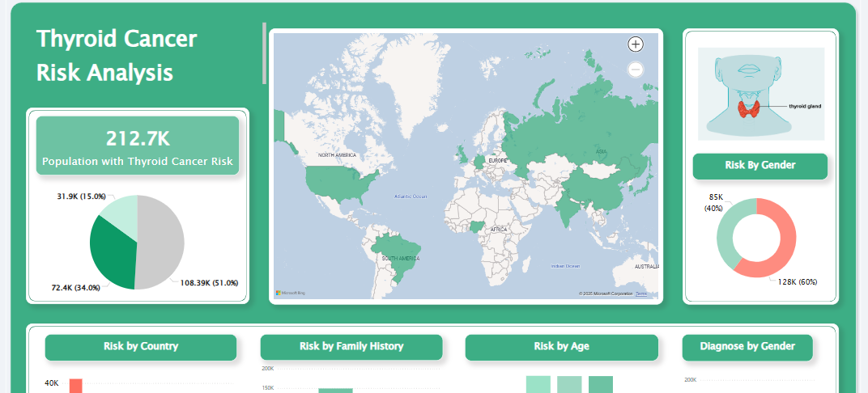
Features
Notes:
Dev 2 Discuss the MAIN FEATURES OF THE APP AT A HIGH LEVEL 1 minute

Slide 7
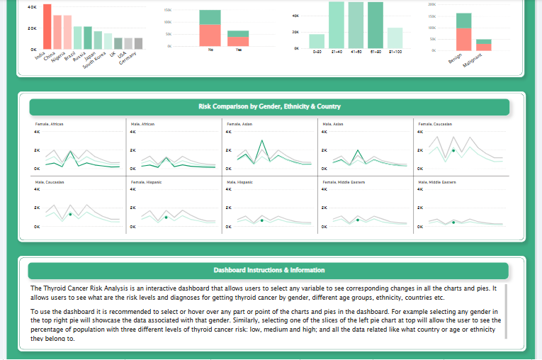
Features
Notes:
Dev 2 Discuss the MAIN FEATURES OF THE APP AT A HIGH LEVEL 1 minute

Slide 8
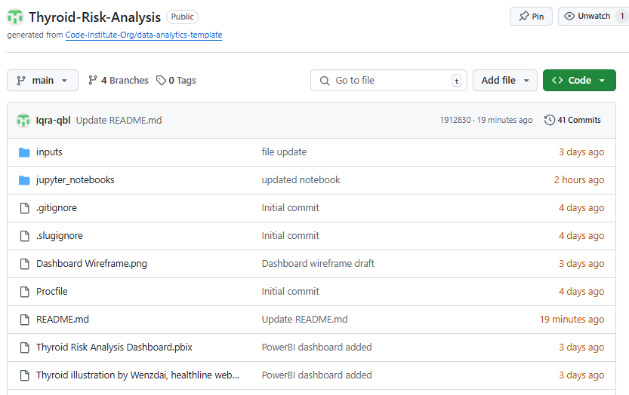
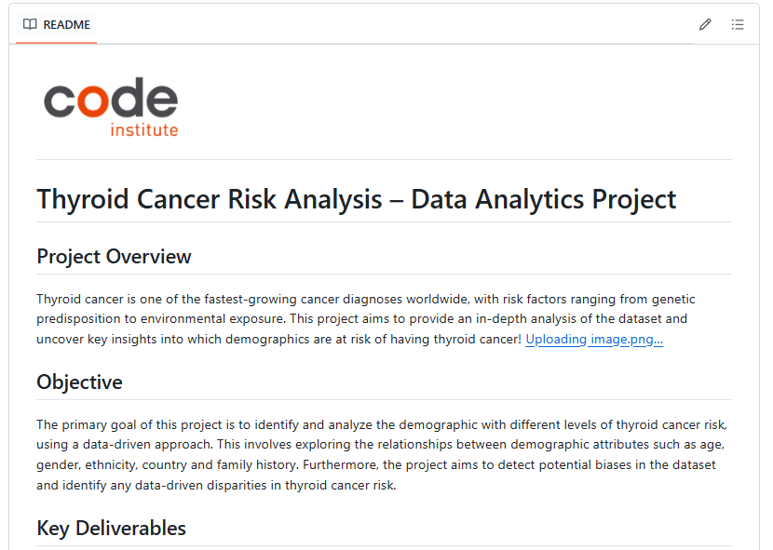
Documentation, Testing & Version Control
GitHub Repository: https://github.com/Iqra-qbl/Thyroid-Risk-Analysis
Notes:
Dev 3 then opens Repo, and exhibits README touching on testing and deployment

Slide 9
Insights & Finding
Key Data Insights
Caucasians are the most represented group, with 63,669 entries, while the Middle Eastern individuals are the least represented, with only 21,335 entries, Asians with 53,261 entries, Africans with 42,414 entries, and Hispanics with 32,012 entries, showing an uneven distribution
Females are more likely to have thyroid cancer especially Asian females
Chi-square test p-value = 0.5102 (p > 0.05), which means no statistically significant difference in the diagnosis proportions across the genders
Chi-squared test p-value for age groups: 0.5586, analysis does not show any bias in thyroid cancer diagnosis based on age groups within this dataset
Most countries show a similar risk distribution: Low risk (~53-54%) with most common category, Medium risk (~35-36%) follows, High risk (~10-11%) is the least frequent in most countries. This suggests that thyroid cancer risk is generally low in most global regions
India Shows a Unique Risk Pattern High-risk individuals make up 32.86% of the population (significantly higher than other countries)
Japan (10.06%) and South Korea (10.50%) have the lowest high-risk proportions

Slide 10
Collaboration & Outcomes
Outcomes
Development Problems
Summary
Outcomes
Collaboration
Summary
Development Problems
Are you happy with the final product? Yes
What do you hope to achieve in the next development cycle?
Fully utilize the dataset to its full potential
What would you do differently if you could start again?
We identified the bias but didn’t take any action on it, we left the dataset as it was because of time constraints and no experience with handling this situation.
Problems that arose during development?:
Git collaboration
In group conflicts and resolutions? No
Did you find any of the behaviour related content useful? Teamwork, problem solving etc?
Yes, mindful collaboration and problem- solving, work division
Interactivity: Overall good
Overall group dynamic:
Good, friendly, professional
Overall satisfaction: 9/10 (-1 for git)
What we learned: github collaboration
Our experiences: We had many issues with git commands but we had good troubleshooting and good mindset for the project
Notes:
All 3 Devs could maybe take a card each here.

Slide 11
Q&A
Notes:
Quick q&a 1 question each from the judges and any questions from the group.

